Slide 1
Visible Surface Detection Method Unit 6 (LH 1)

Slide 2
Visible Surface Determination
It is the process of identifying those parts of a scene that are visible from a chosen viewing position.
There are numerous algorithms for efficient identification of visible objects for different types of applications.
These various algorithms are referred to as visible-surface detection methods. Sometimes these methods are also referred to as hidden-surface elimination methods.
•To identify those parts of a scene that are visible from a chosen viewing position (visible-surface detection methods).
•Surfaces which are obscured by other opaque surfaces along the line of sight are invisible to the viewer so can be eliminated (hidden-surface elimination methods

Slide 3
Visible surface detection methods are broadly classified according to whether they deal with objects or with their projected images.
These two approaches are
1. Object-Space methods:
2. Image Space Methods
Object Space Method:
• Compares objects and parts of objects to each other within the scene definition to determine which surface as a whole we should label as visible.
• Deal with object definition
• E.g. Back-face detection method

Slide 4
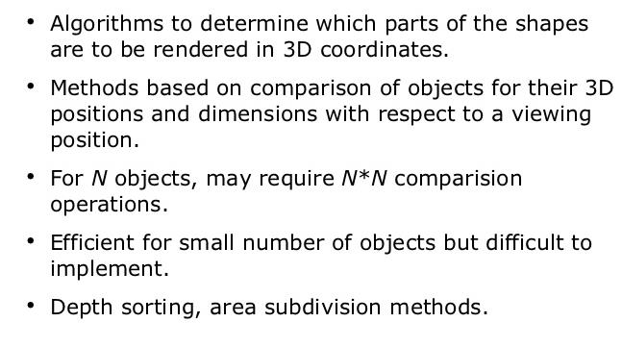
Object-Space Methods

Slide 5
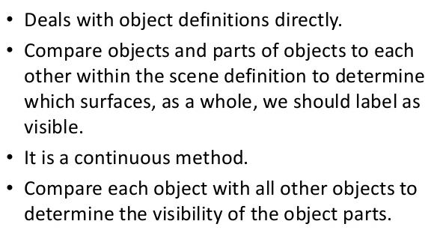

Slide 6
2. Image-Space methods:
• Visibility is decided point by point at each pixel position on the projection plane.
• Deal with projected image
• E.g. Depth-buffer method, Scan-line method, Area-subdivision method

Slide 7
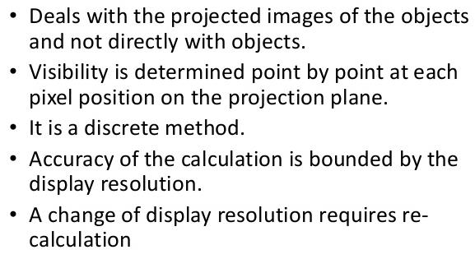
Image Space Methods

Slide 8
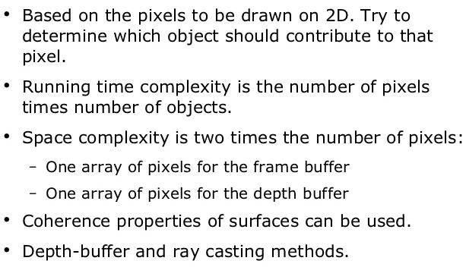

Slide 9
Back Face Detection Methods
In a solid object, there are surfaces which are facing the viewer (front faces) and there are surfaces which are opposite to the viewer (back faces).
These back faces contribute to approximately half of the total number of surfaces. Since we cannot see these surfaces anyway, to save processing time, we can remove them before the clipping process with a simple test.
Each surface has a normal vector. If this vector is pointing in the direction of the center of projection, it is a front face and can be seen by the viewer.
If it is pointing away from the center of projection, it is a back face and cannot be seen by the viewer.

Slide 10
The test is very simple, if the z component of the normal vector is positive, then, it is a back face. If the z component of the vector is negative, it is a front face. Principle:
➢ Remove all surfaces pointing away from the viewer
➢ Eliminate the surface if it is completely obscured by other surfaces in front of it
➢ Render only the visible surfaces facing the viewer Back facing and front facing faces can be identified

Slide 11
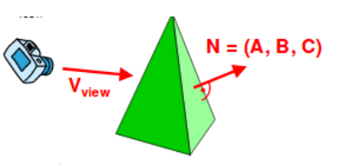
using the sign of V • N where V is the view vector and N is normal vector.
➢ If V • N > 0, back face
➢ if V • N < 0 front face
➢ if V • N= 0 on line of view

Slide 12
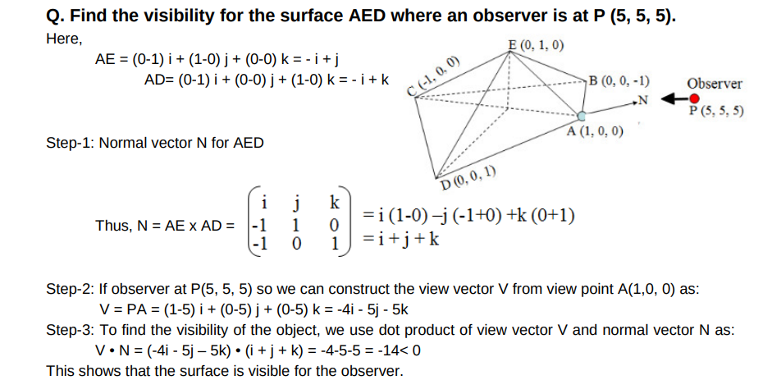

Slide 13
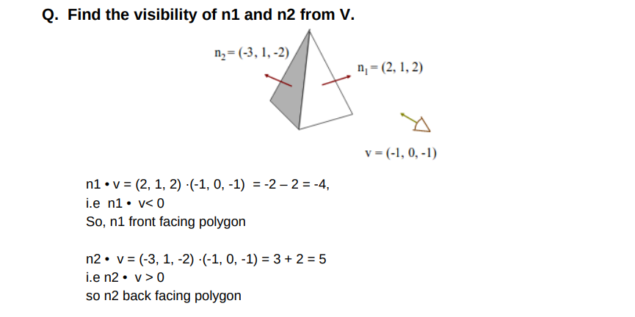

Slide 14
2. Depth Buffer Method (Z-Buffer Method)
A commonly used image-space approach to detecting visible surfaces is the depth-buffer method, which compares surface depths at each pixel position on the projection plane.
• Also called z-buffer method since depth usually measured along z-axis. This approach compares surface depths at each pixel position on the projection plane.
• Each surface of a scene is processed separately, one point at a time across the surface. And each (x, y, z) position on a polygon surface corresponds to the projection point (x, y) on the view plane.

Slide 15
This method requires two buffers:
• A z-buffer or depth buffer: Stores depth values for each pixel position (x, y).
• Frame buffer (Refresh buffer): Stores the surface-intensity values or color values for each pixel position.
• As surfaces are processed, the image buffer is used to store the color values of each pixel position and the z-buffer is used to store the depth values for each (x, y) position.

Slide 16
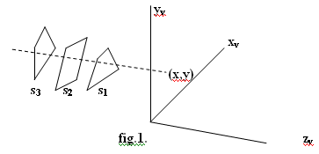

Slide 17
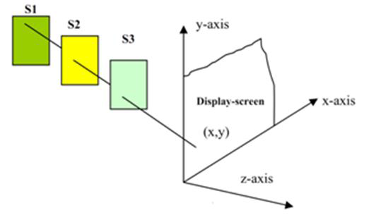

Slide 18
Algorithm
Step-1 − Set the buffer values −
➢ Depth buffer (x, y) = 0
➢ Framebuffer (x, y) = background color
Step-2 − Process each polygon (One at a time)
➢ For each projected (x, y) pixel position of a polygon, calculate depth z.
➢ If Z > depth buffer (x, y) - Compute surface color, - set depth buffer (x, y) = z,
- framebuffer (x, y) = surface color (x, y)

Slide 19
Advantages
• It is easy to implement.
• It reduces the speed problem if implemented in hardware.
• It processes one object at a time.
Disadvantages
• It requires large memory.
• It is time consuming process.

